Slide 1

PROJECT ON REAL ESTATE PORTAL
PRESENTED BY -
HEMANTH BS (202319009)
ABHAY KUMAR (202319012)

Slide 2
OBJECTIVE –
A platform for buyers,sellers and agents who can interact with each other.
Facilitating seamless access to comprehensive information encompassing property ownership details, location, age of the property, pricing, contact information, and a detailed property description for the convenience of buyers, and real estate agents, all consolidated within a singular platform.

Slide 3
FUNCTIONALITIES -
USERS() | ADMIN()
Users can see property details | Admin can add property list for users.
Users can search about specific property according to his interest. | Administrators have the ability to review and search for properties in a particular location according to his preferences.
Users can query about specific details of property . | Administrators have the authority to remove a particular property if they detect any suspicious activity or issues or if it is sold out.
 | Admins can import and export data. Admins can view enquery about property asked by users.

Slide 4
ASSUMPTION -
Python 3 should be installed in PC.
For database ,postgres (pgadmin 4 v 7) should be installed.
Installing Pandas
OUT OF SCOPE FUNCTIONALITIES –
Installation of Streamlit library for user interface

Slide 5
TOPICS FROM THE COURSE COVERED IN THE PROJECT
List | Conditional Statements(nested statements)
Tuple | Library(Pandas,psycopg2)
List comprehension | Files handling
Loop | SQL
Functions | Formated String
Modules

Slide 6
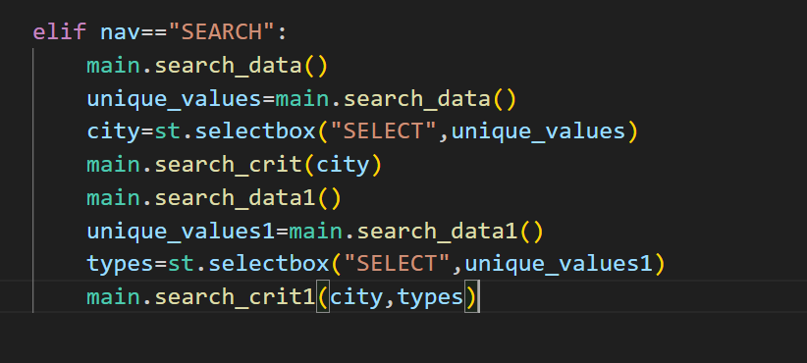
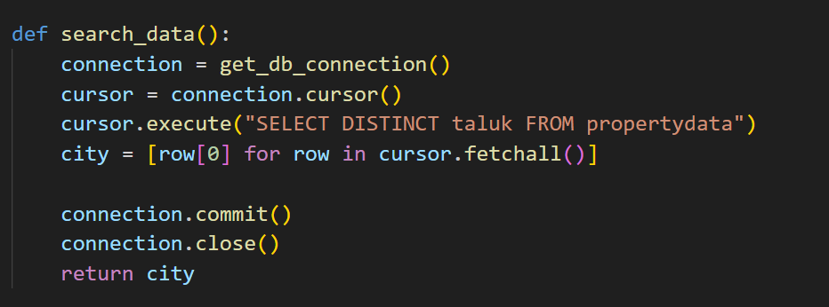
USERS(),main()

Slide 7
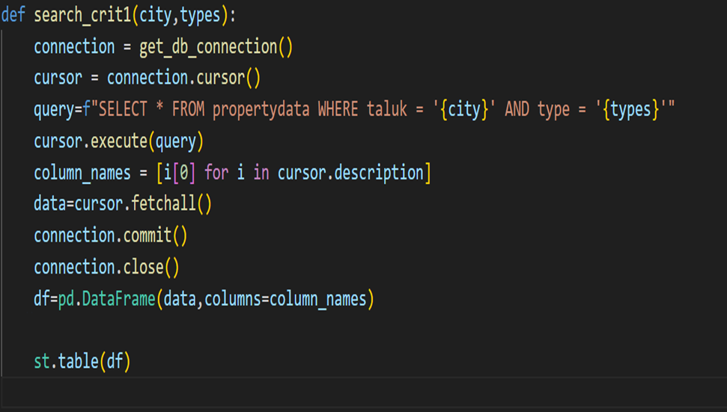
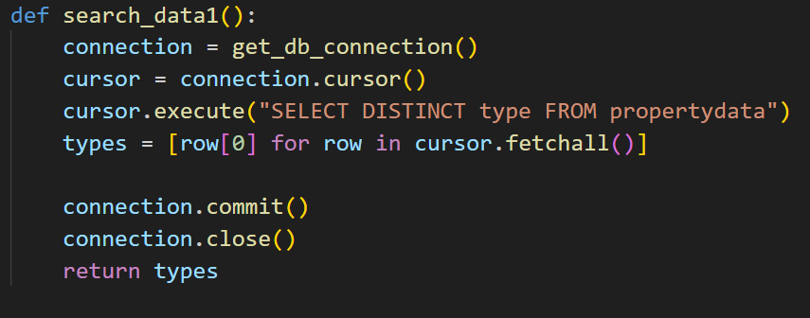

Slide 8
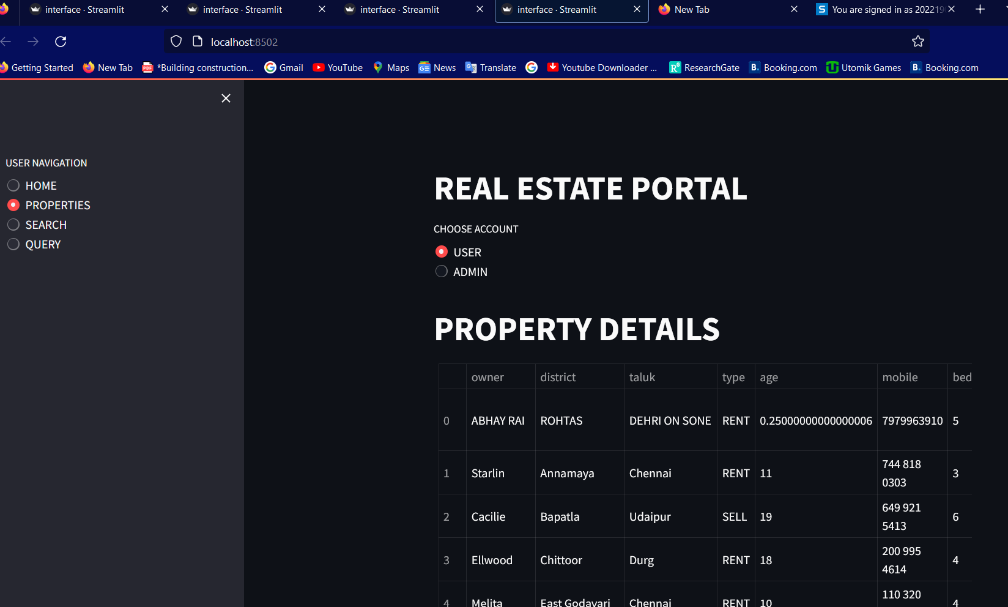
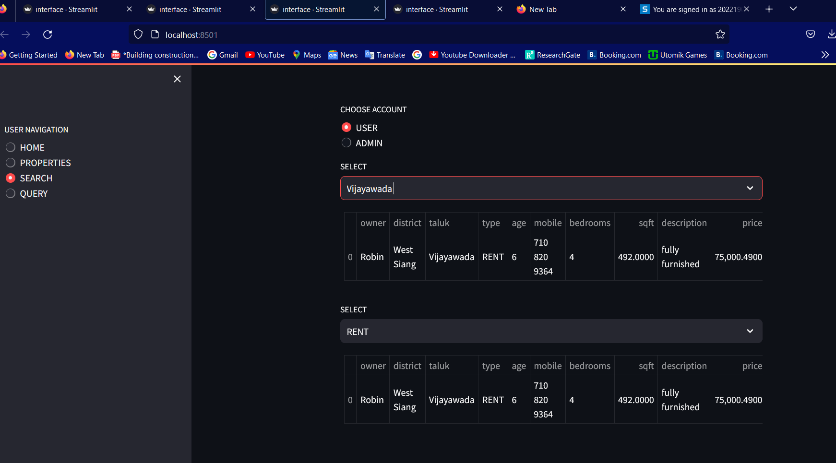
Users()

Slide 9
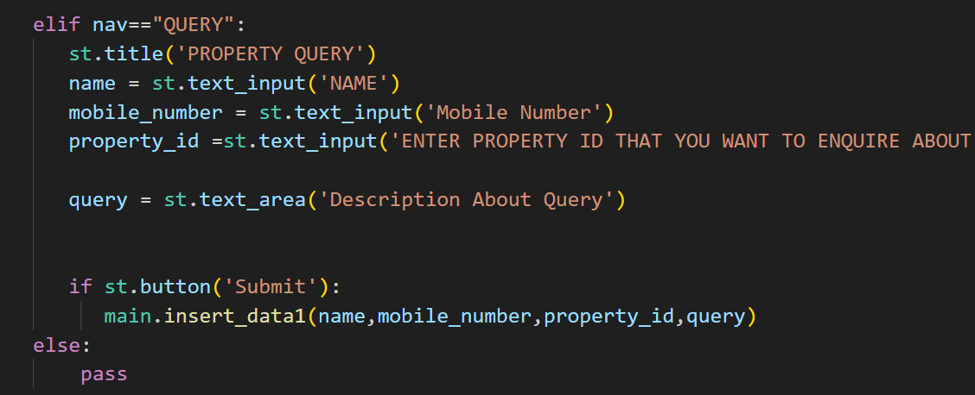
Users() adding QUERY

Slide 10
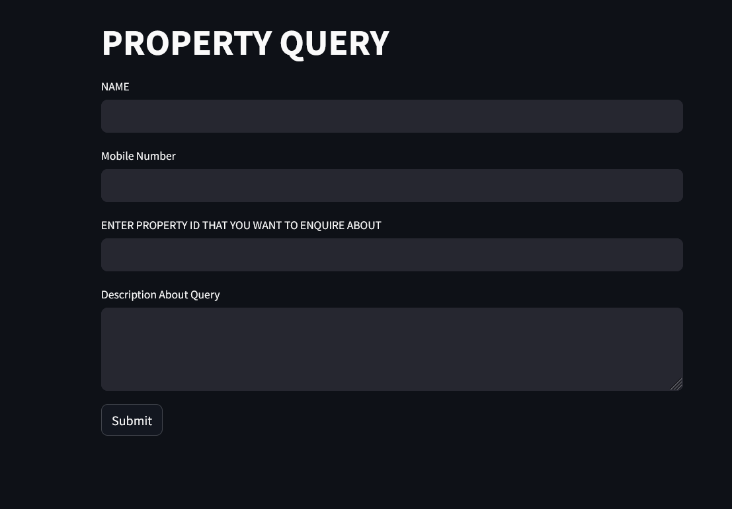
PROPERTY QUERY

Slide 11
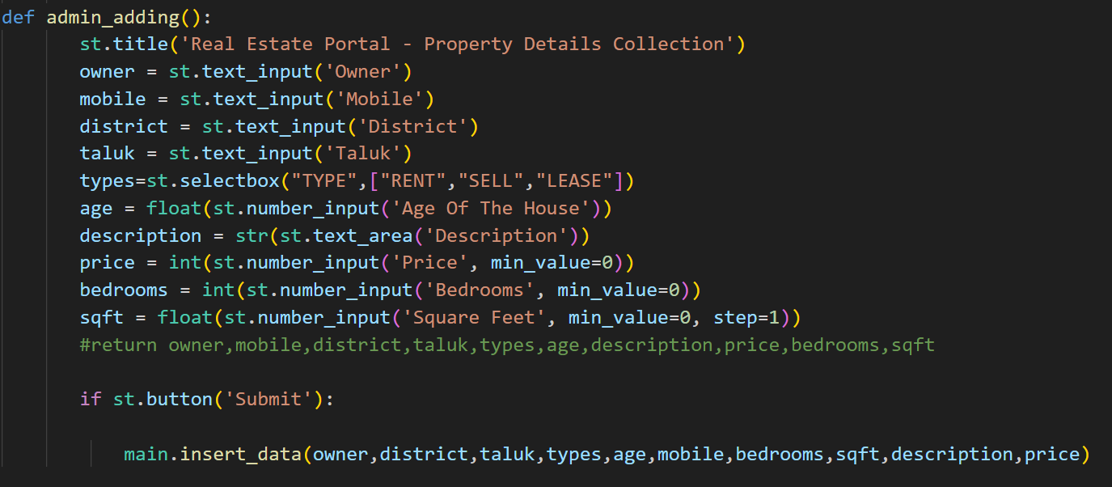
ADMIN_ADDING()

Slide 12
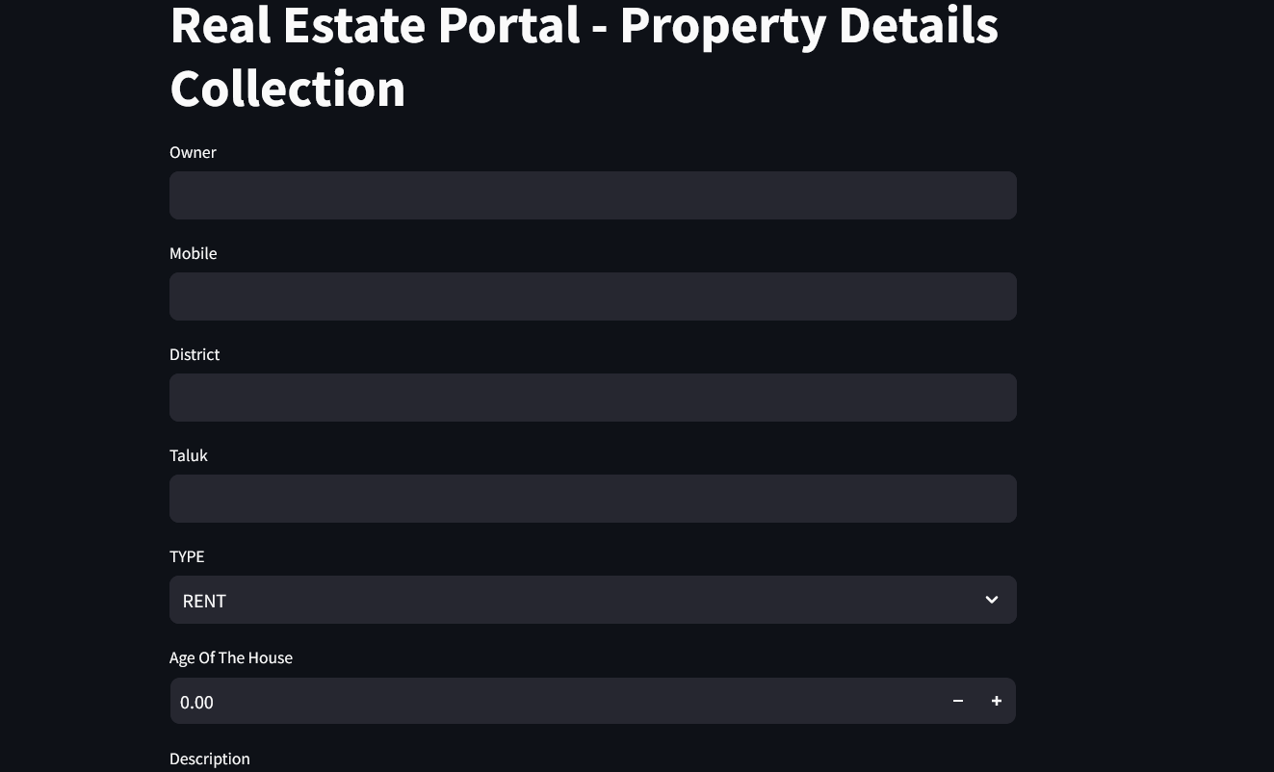
ADDING DATA BY ADMIN()

Slide 13
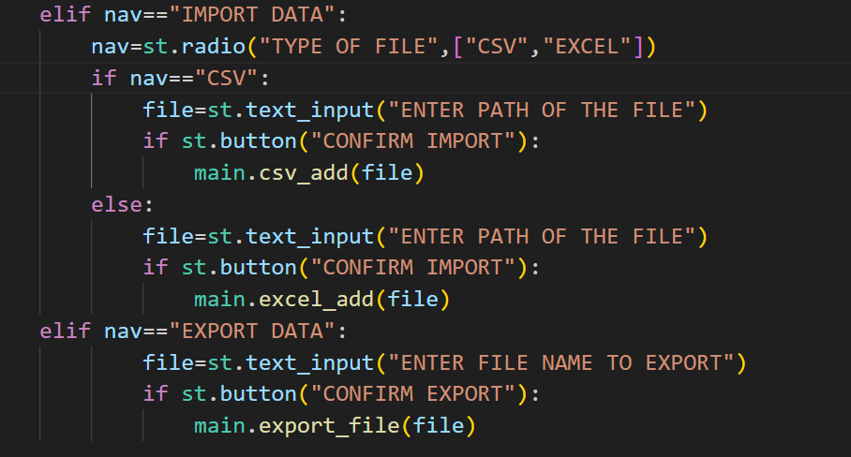
ADMIN()[Importing data through csv]

Slide 14
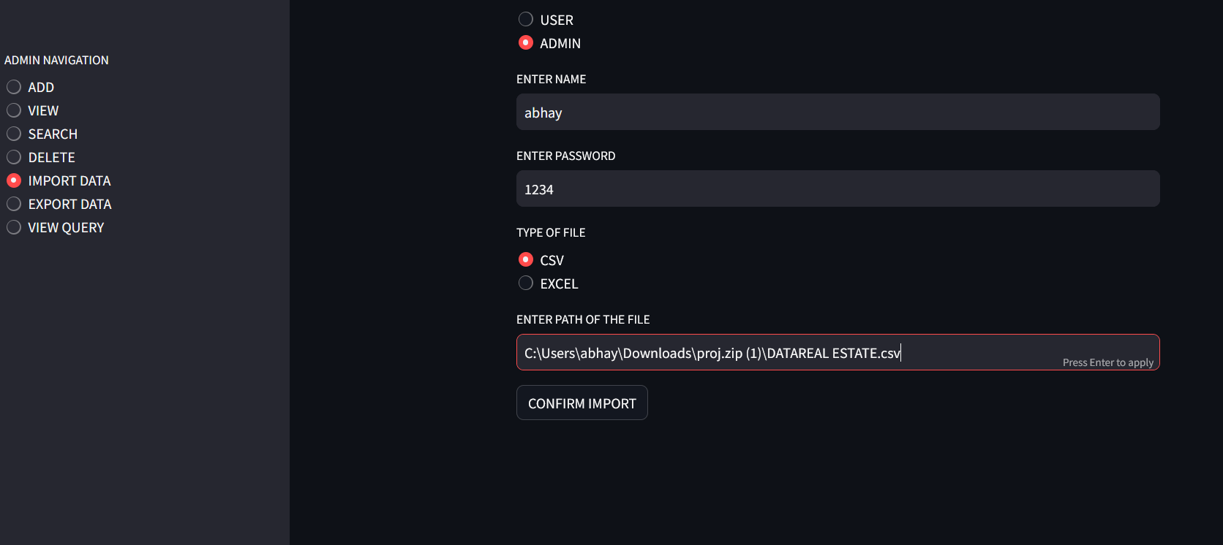
Importing DATA THROUGH CSV

Slide 15
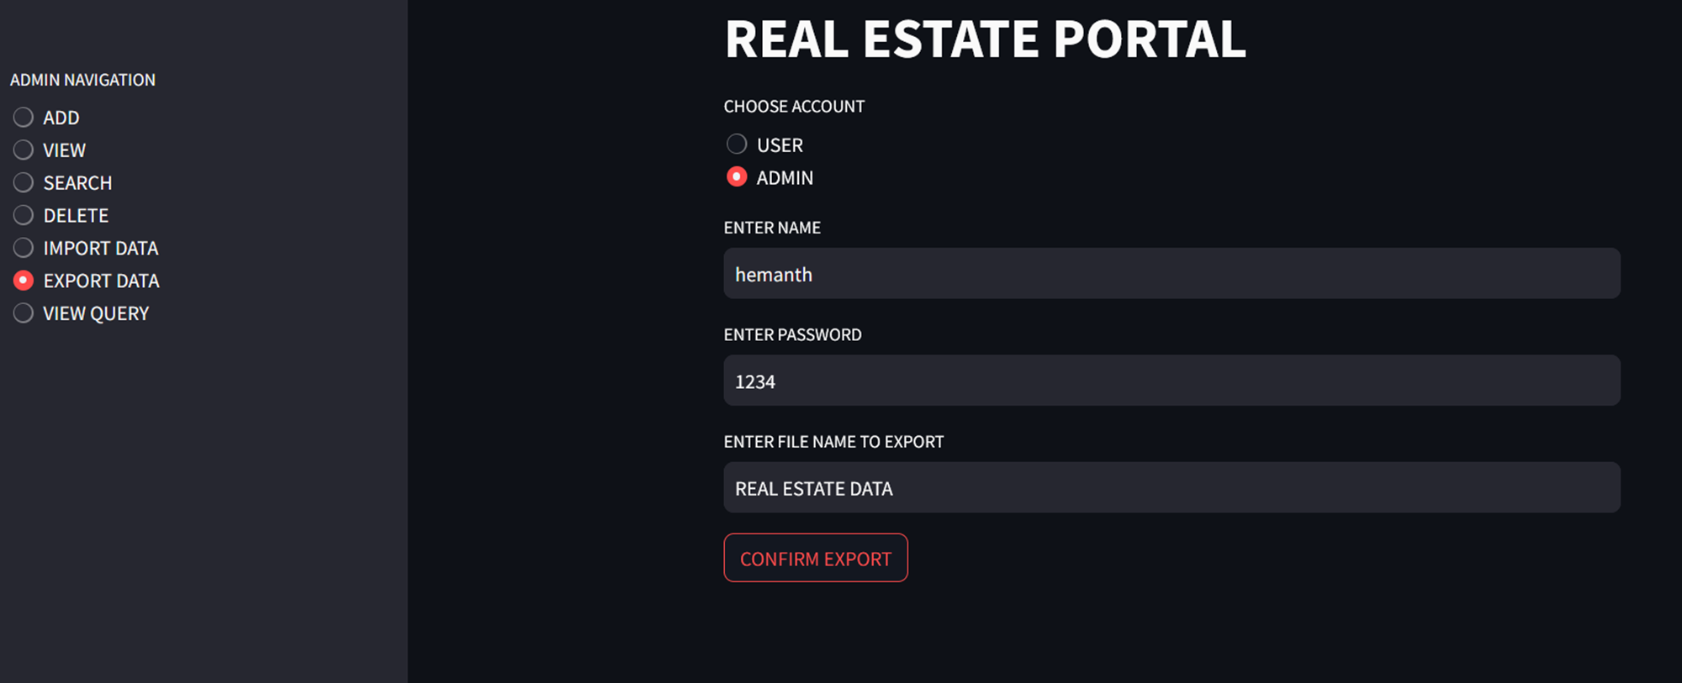
Exporting data to csv format

Slide 16
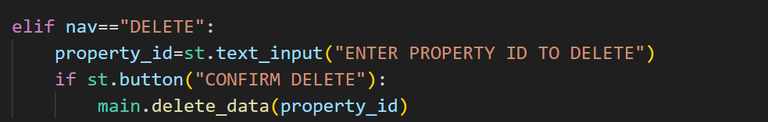
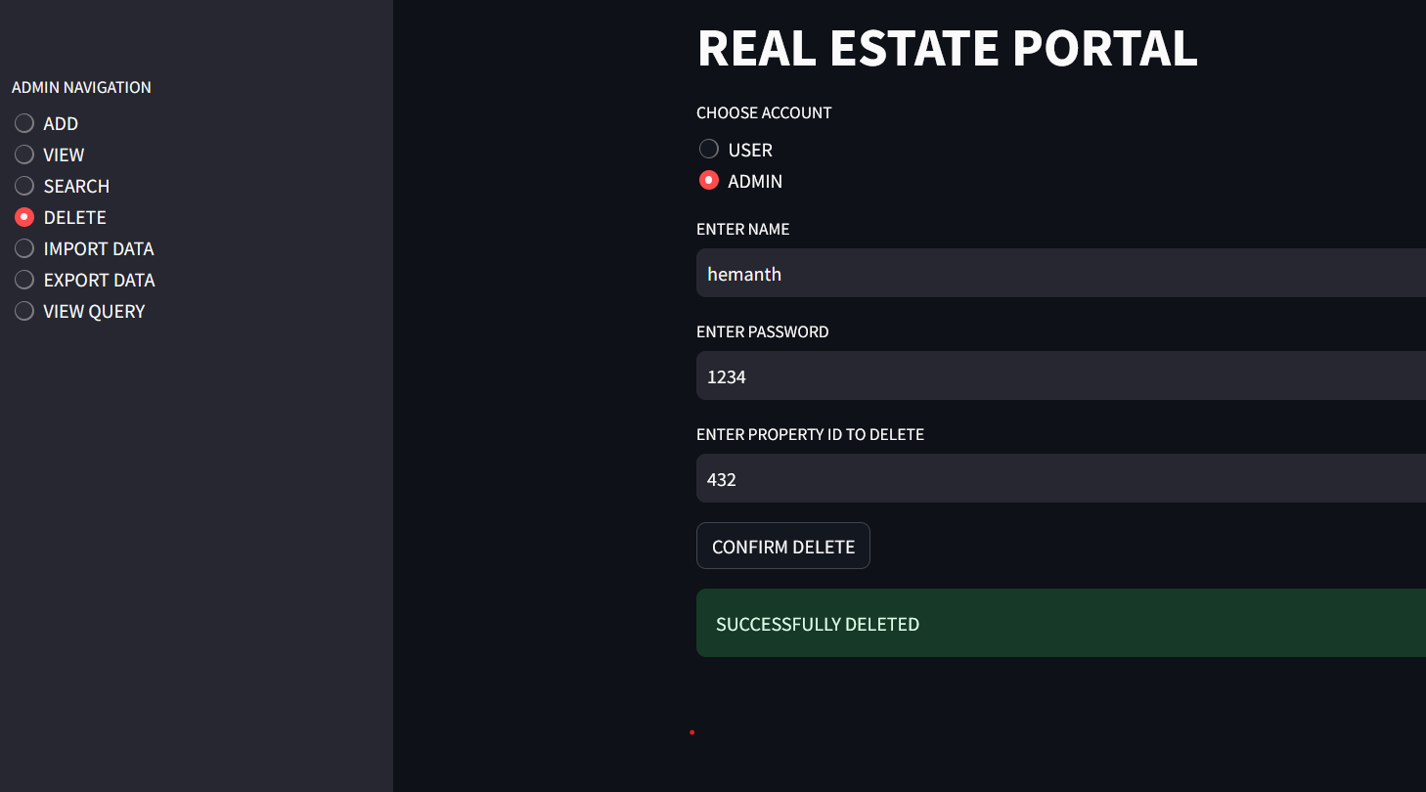

Slide 17
CONCLUSION…
User-Friendly Interface: The portal offers an intuitive and user-friendly interface, allowing users to easily browse and search for properties based on their preferences.
Property Management: Developed a comprehensive property management system that allows administrators to add, view, and delete property listings efficiently.
Database Integration with SQL: Utilized SQL for efficient data storage and retrieval, ensuring scalability and performance as the platform grows.

Slide 18
THANK YOU…..

